Slide 1




Automated Detection of Conduction Mechanisms in Dielectric Films Using I–V Data Analysis
Presented by Vishal Kumar, VNIT Nagpur, 11 July 2025
Notes:
1

Slide 2
Project Objectives
To Segment I-V data using local slope analysis for distinct conduction regions(i.e. SET/RESET).
To Identify the best-fitting mechanism(s) for each region using statistical criteria (R², slope).
To Visualize segmentation and mechanism assignment on log-log I-V plots.
Notes:
2

Slide 3
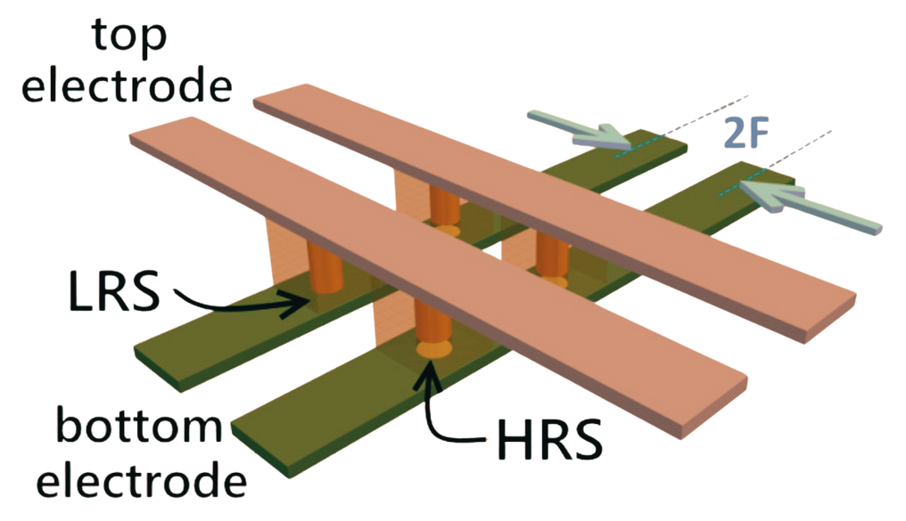
Overview of Conduction Mechanisms
The types of conduction mechanisms include:
Ohmic
Space-Charge-Limited Conduction (SCLC)
Trap Filled SCLC
Schottky Emission
Fowler-Nordheim Tunneling
Poole-Frenkel Emission
Direct Tunneling
Trap-Assisted Tunneling
Notes:
5

Slide 4
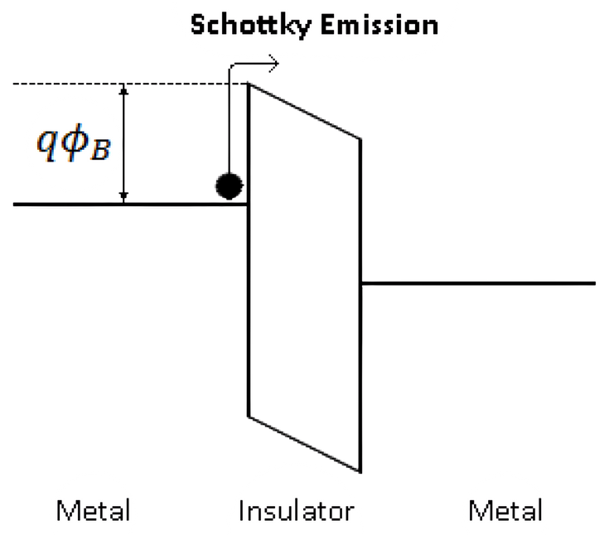
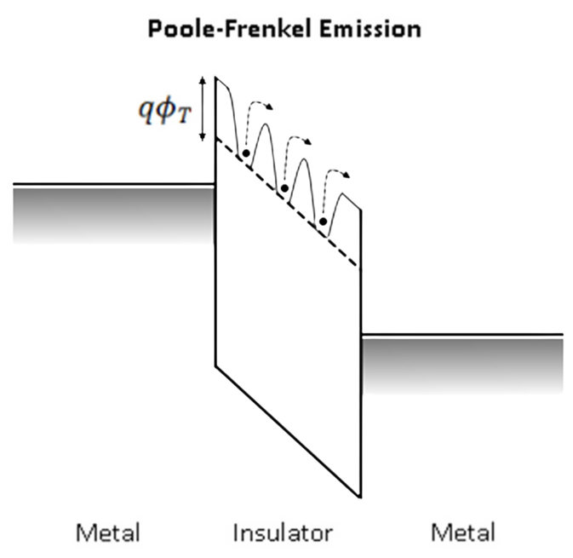
Conduction Mechanisms
Ohmic
Conduction due to free carriers in the material.
Equation: I ∝ V
Typical plot: log(I) vs log(V) (linear)
SCLC (Space-Charge Limited Conduction)
Current limited by space charge due to injected carriers.
Equation: I ∝ V2
Typical plot: log(I) vs log(V), slope ≈ 2
Poole-Frenkel Emission
Field-enhanced thermal emission of electrons from traps in the bulk.
Equation: log(I/V) ∝ sqrt(V)
Typical plot: log(I/V) vs sqrt(V)
Schottky Emission
Thermionic emission of electrons over a field-lowered barrier at a metal–semiconductor interface.
Equation: log(I) ∝ sqrt(V)
Typical plot: log(I) vs sqrt(V)
Notes:
6

Slide 5
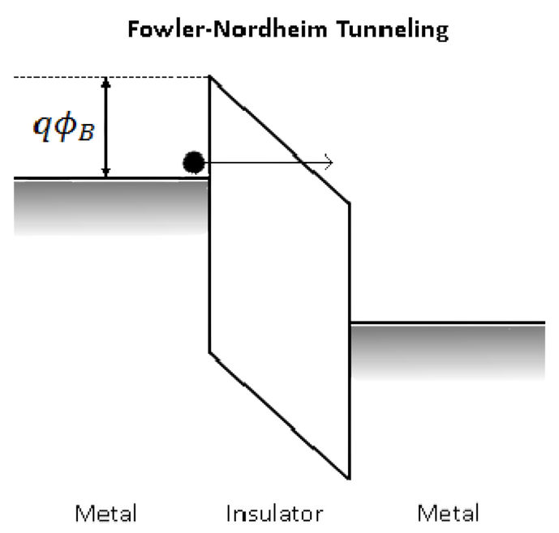
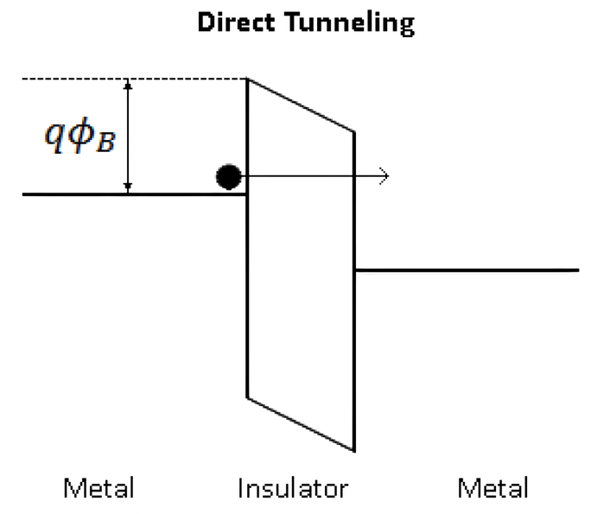
Trap Filled SCLC
Occurs when traps in the material are filled and current increases rapidly.
Equation: I ∝ Vn, with n>2
Typical plot: log(I) vs log(V) (slope > 2, typically 3–5)
Fowler-Nordheim Tunneling
Quantum tunneling of electrons through a triangular energy barrier.
Equation: log(I/V²) ∝ (-1/V)
Typical plot: log(I/V²) vs 1/V
Direct Tunneling
Quantum tunneling of electrons through a thin, rectangular barrier.
Equation: log(I/V) ∝ (1/V)
Typical plot: log(I/V) vs 1/V
Trap-Assisted Tunneling
Electron tunneling via traps within the dielectric bandgap.
Equation: log(I) (\propto) (-1/V)
Typical plot: log(I) vs 1/V
Notes:
7

Slide 6
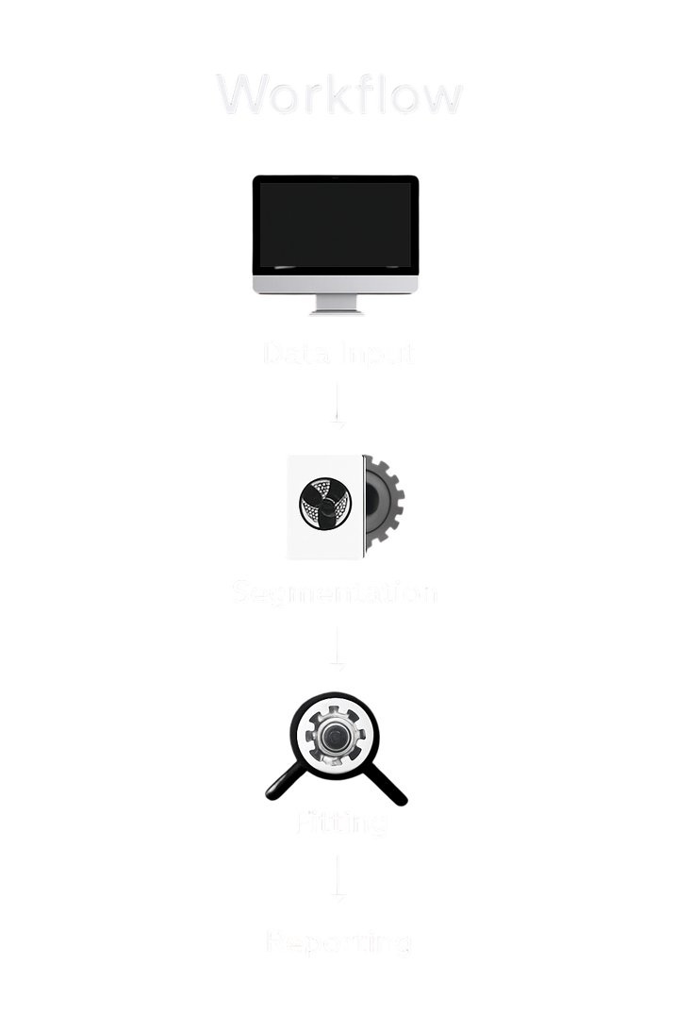




Workflow & Automation
Data Input
Raw I-V data in CSV format.
Segmentation
Sliding window slope analysis on log-log plots.
Fitting All Mechanisms
Applying mathematical models for each conduction mechanism.
Reporting Best Fits
Identifying the most probable mechanism based on R2.
Notes:
8

Slide 7
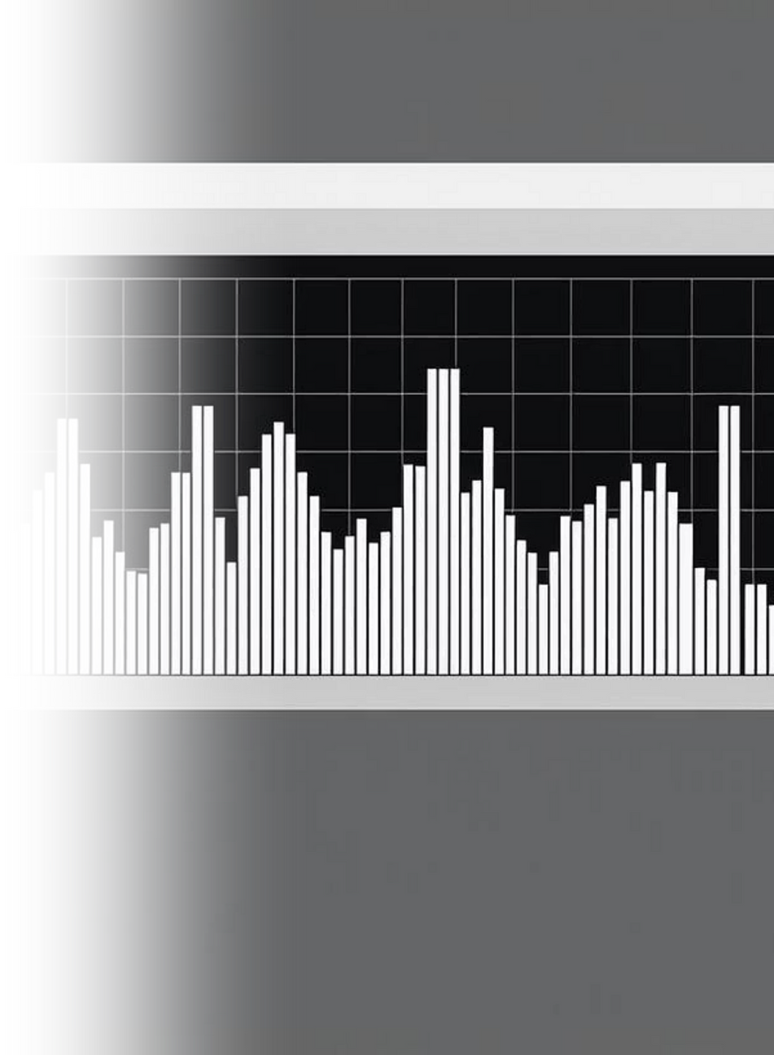
Data Preparation
The data format used is I–V CSV.
df = pd.read_csv(“RRAMdevice1.csv”)
Preprocessing steps include:
Filtering
mask = (np.abs(V) > 1e-12) & (np.abs(I) > 1e-15)
Log transforms
logV = np.log10(np.abs(V[mask]))
logI = np.log10(np.abs(I[mask]))
Notes:
3

Slide 8
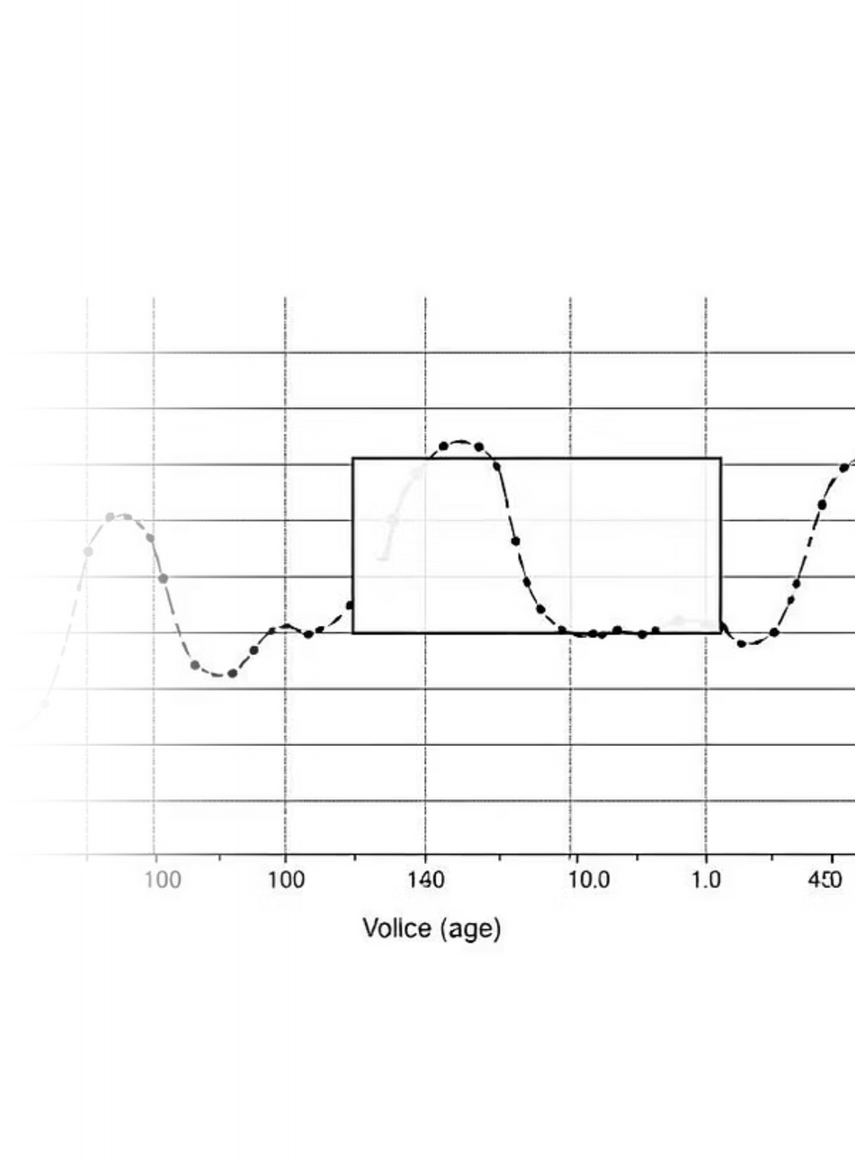
Segmentation Approach
Our approach involves:
Sliding window slope analysis on log-log (log(I) vs log(V)) plots.
Slope smoothing and segment detection based on thresholds.
def segment_loglog(logV, logI, window=4, tolerance=0.08, min_points=8):
Notes:
4

Slide 9
Fitting Methology
Mechanism Assignment Functions
For Ohmic, SCLC, Trap filled SCLC
def classify_loglog_segment(logV, logI, tol=0.2, r2_th=0.98)
For the Other Mechanisms
def classify_special_segment(V, I, r2_th=0.98)
Mechanism Check Functions
def is_ohmic(logV, logI, tol=0.2, r2_th=0.98)
if abs(slope - 1) < tol and r2 > r2_th
def is_sclc(logV, logI, tol=0.2, r2_th=0.98)
if abs(slope - 2) < tol and r2 > r2_th
def is_schottky(V, I, r2_th=0.98)
def is_fn_tunneling(V, I, r2_th=0.98)
if r2 > r2_th

Slide 10
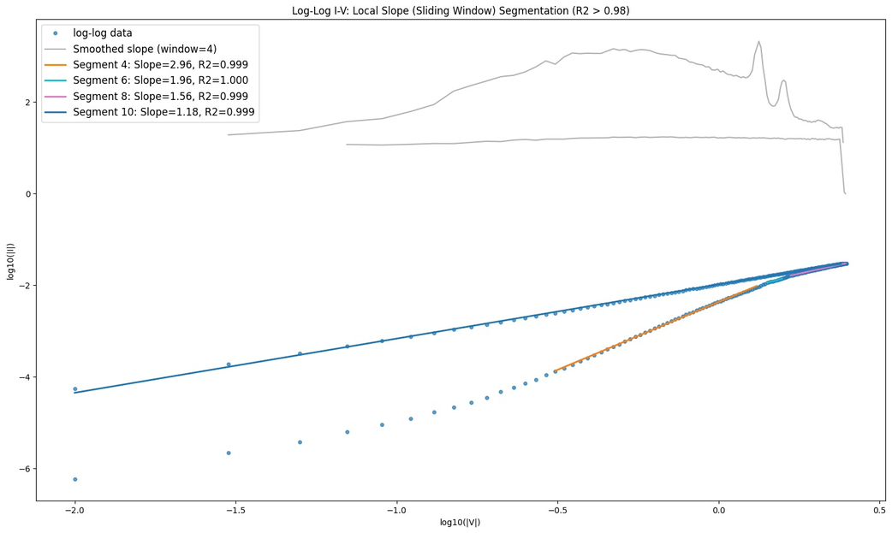
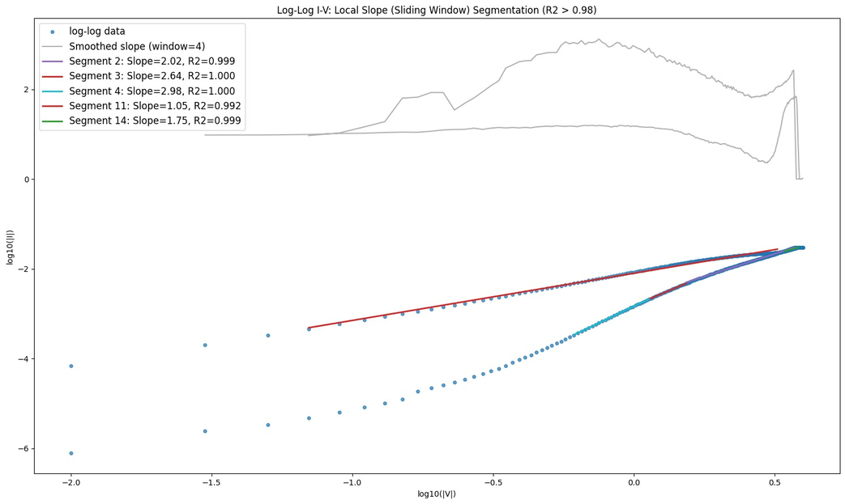
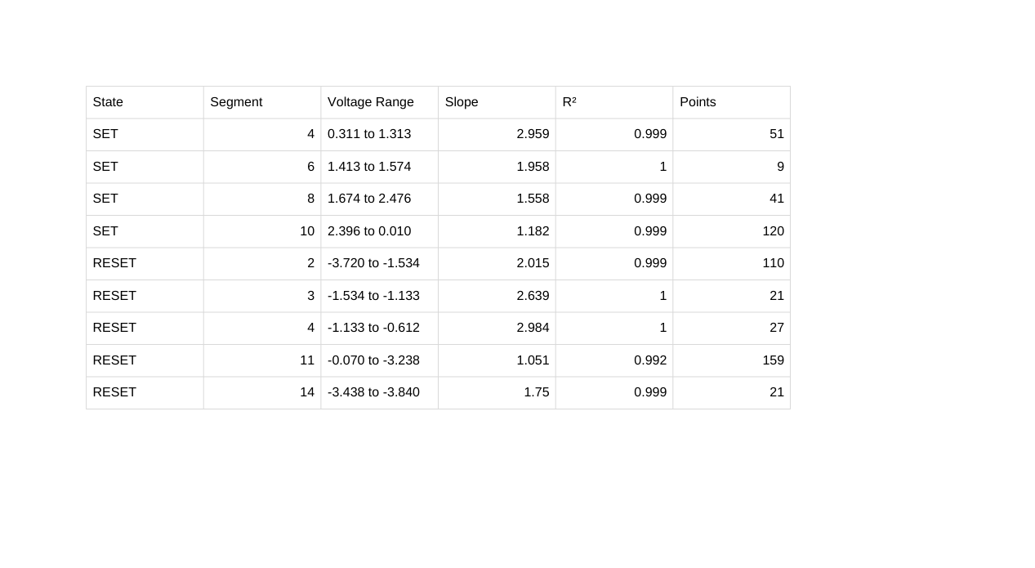
Results & Visualization
Example plots include:
Log-log with segments
Slopes with their R2 value
Voltage ranges for the slopes
SET Process Slope Analysis
R² is used to select the best fit.
RESET Process Slope Analysis
Notes:
9

Slide 11
Challenges
Presence of noise or limited data points in some I-V segments.
Presenting complex fitting results in a clear and concise manner.
Automating the identification process without manual intervention.
Solutions
Employed region-wise fitting and used statistical metrics (R², slope) for validation.
Utilized robust fitting algorithms and careful segment selection to minimize noise effects.
Enhanced segmentation and performed manual verification for ambiguous transitions.
Used annotated plots and summary tables to effectively communicate results.
Notes:
10

Slide 12
Conclusions
Developed an automated workflow for conduction mechanism analysis in SET and RESET states of RRAMs.
Successfully segmented I-V data and performed region-wise fitting to multiple conduction models.
Current mechanism identification did not fully match expectations, likely due to data quality or fitting limitations.
Despite these challenges, the methodology is robust and results are largely consistent with physical understanding.
Future Works
Refine fitting approach and address anomalous regions within the next two days.
References
Conduction Mechanism of Valence Change Resistive Switching Memory:
A Survey by Ee Wah Lim and Razali Ismail
Chiu, Advances in Materials Science and Engineering, 2014

Slide 13
thank
you
Q&A

